Slide 1
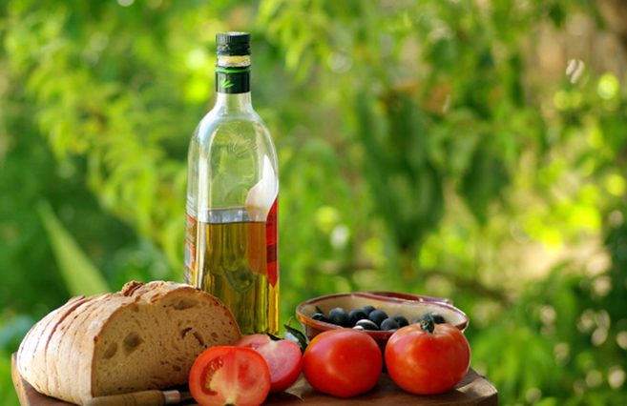
MEDITERRANEAN DIET
ΤΗΕ WAY TO LIVE

Slide 2
DEFINITION
The term Mediterannean Diet was coined to describe a model of diet which has been followed by the people of the Mediterranean countries for centuries.
It is considered a healthy and traditional way of living, which, in combination with physical activity, provides longevity and well being. More particularly, during the last decades the role of Mediterranean diet has been universally acknowledged thanks to scientific studies and research.

Slide 3
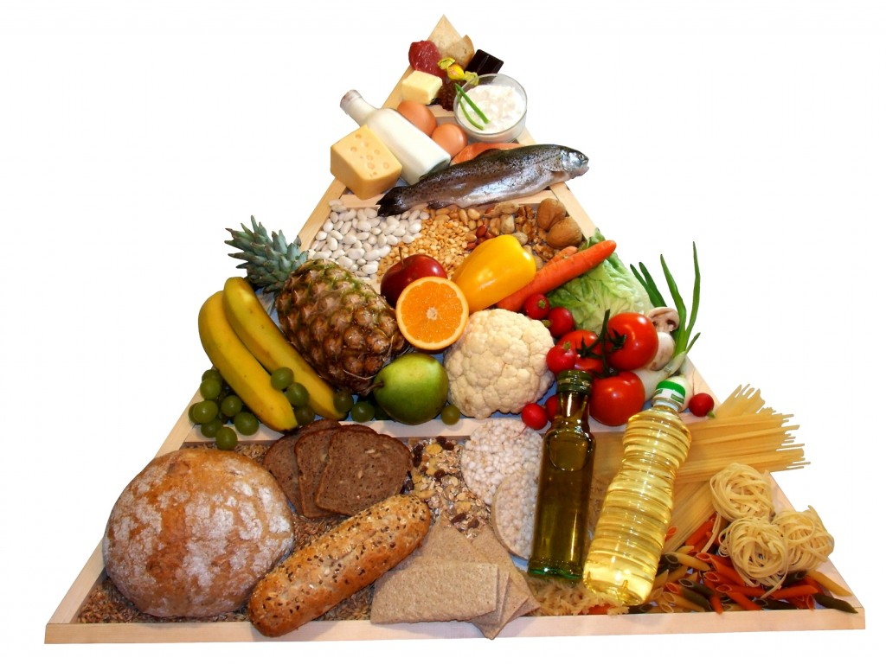
Let food be your remedy and remedy be your food Hippocrates(460-377 B.C. )
The Mediterranean lifestyle combines balanced diet with delight.
Specialists have depicted Mediterranean diet as a a pyramid where all its constituents are presented.At the bottom of it we find the foods we should eat on a daily basis while as we go upwards we find foods which should be consumed in smaller quantities and less often.

Slide 4
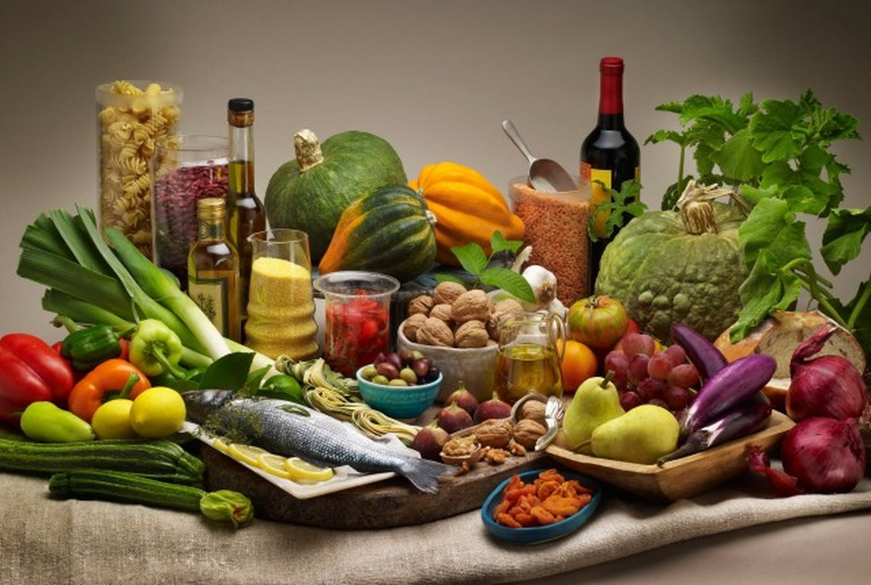
Constituents of the Mediterranean Diet
Plenty of fibres (fruit, vegetables, bread and cereals -preferably whole grained- potatoes, seeds)
Only a few processed products
Dairy products (mainly cheese and yoghurt) in small to medium quantities
Fish and poultry in small to medium quantities
Red meat twice a month
Olive oil as a basic ingredient of all dishes

Slide 5
THE BENEFITS OF THE MEDITERRANEAN DIET
Protects against artery blockage and various forms of cancer
Tones up the body's defence
Helps in intestine's well functioning
Protects against obesity
Is identified with health, longevity and beauty
Furthermore, as it stands in the centre of social events, it brings people together through gathering around a table and contributes to good physical and mental health.

Slide 6
CULTURAL HERITAGE
In 2010 UNESCO registered the Mediterranean Diet on the list of non material cultural heritage of humanity in the light of a common request submitted by Italy ,Greece Spain and Marocco, which are respectively represented by Cilento, Koroni, Soria and Chefchaouen as emblematic communities. Since then, Cyprus, Portugal and Croatia have joined the network.

Slide 7
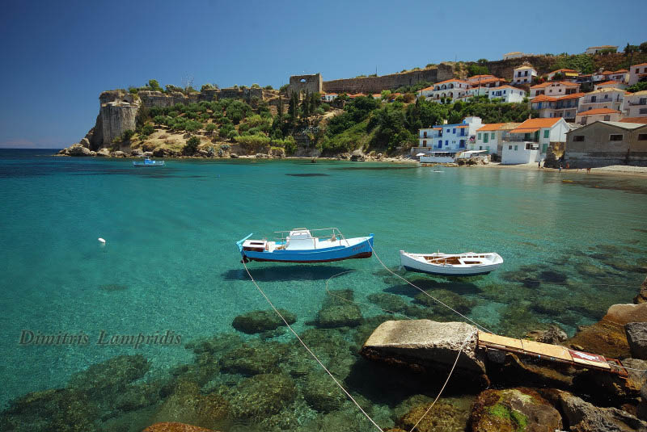
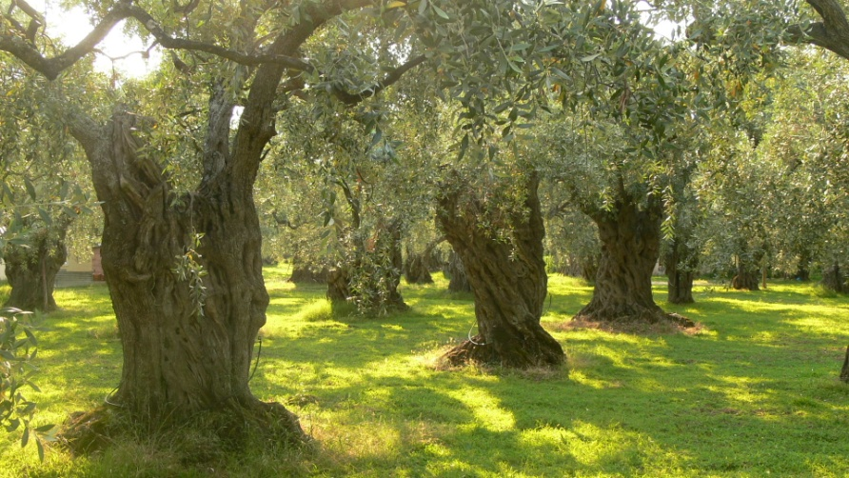
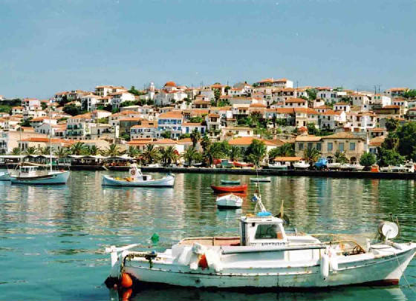
KORONI
‘I come from a small country. A stone cape in the Mediterranean, which has no other commodity but the people's struggle, the sea and the sun's light. Our place might be small but its tradition is vast and what characterises it is that it was given to us uninterrupted.' Giorgos Seferis (a Nobel for Literature, 1963)
‘Deep sea blue and olive trees like gold'

Slide 8
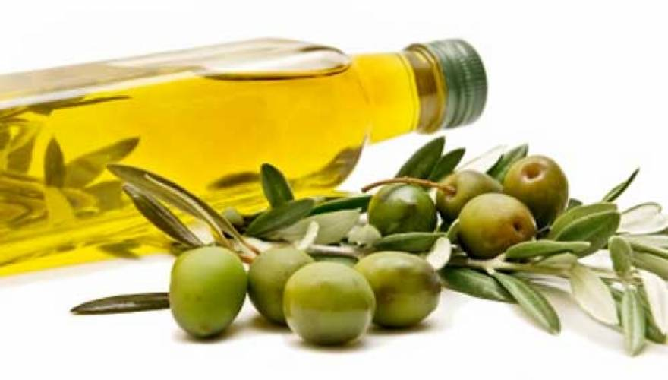
The holy symbols of the Mediterranean culture
OLIVE OIL
It is produced under adverse weather conditions in the Meiterranean countries.
The olive tree, since ancient times, has nurtured and cured generations after generations. In Christianity, during the mystery of Baptism, the priest forms a cross on the forehead of the baptised, who is anointed with oil to escape from battles against the devil.
Also, the religiously orthodox oil lamp still burns on oil even today in every Greek house.

Slide 9
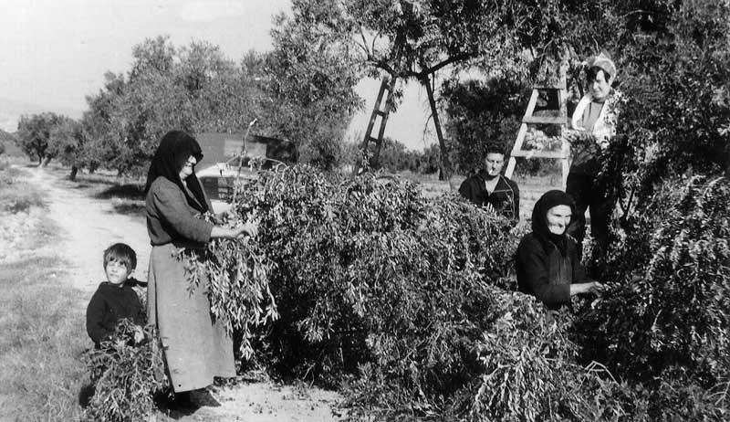
A FAMILY TASK
Harvesting the olive tree in the Greek countryside was a family task, which would wake up all its members very early in the morning, and lasted all day long. Until today harvesting begins in November and typically ends at Christmas.

Slide 10
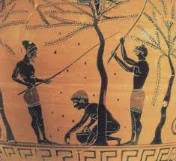
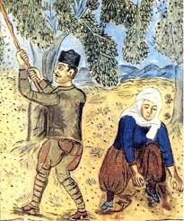
    Harvesting olives is a process which has been the same for 5000 years.It even signifies the time of the year.

Slide 11
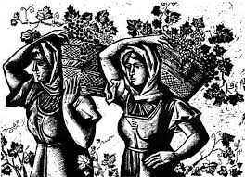
WINE
Give him wine to let the truth out...
(Greek proverb)
The traditional 'drink', which is found in every Greek home, could not but be included in the Mediterranean diet. Grape harvesting takes place between the end of August to and the beginning of September. The process of harvesting is called 'trigos' and it is a family task as well.

Slide 12
Bread
.
Starch (carbohydrate) : it provides the body with the necessary energy to cope with various activities
Cellulose (carbohydrate) : it is necessary for digestion and intestine's well functioning
Vitamin E : it has anti oxidotic qualities, maintains blood vessels healthy and it helps with reproduction
Potassium : it helps body cells maintain a balanced quantity of water, it is a basic activator of a number of enzymes, it stabilises the internal structure of body cells and it even helps the heart muscles and the skeleton to increase their stimulating ability so that they become more receptive to nerves' thrusts.
Sodium : it helps transmit nerves' thrusts, carry out muscle contortions,preserve water balance between body cells and surrounding fluids (like potassium) as well as actively transfer nutrient amino-acids and glycose into the body cells.
Vitamins B : (Β1, Β2, νιασίνη) they are responsible for maintaining the nervous ans digestive system as well as skin in good condition.

Slide 13
The Mediterranean diet, an important pillar f economic activity
One of the most important commodities for our area as well as for our country is olive oil and olives, which are considered of the best varieties in the world. A recent pioneering study of the Davis University in California has scientifically confirmed the universally good reputation of the Messinian olive oil. More specifically, our variety is rich in substances which decrease the risk of artery blockage and brain stroke, that is they act in the same way as aspirin and non steroid, inflammatory medicine.

Slide 14

'Tell me what you eat and I will tell you who you are...
Nowadays, due to the globalisation of eating habits-one of which is the consumption of fast food, which is presented as (and might actually be) more delicious-and its adverse effects (obesity and accompanying diseases) important steps have been taken towards education of nutrition by introducing teaching material in schools and the offer of healthy traditional snacks at school canteens. All the above, of course should be combined with psical activity, as 'a healthy mind dwels in a healthy body'.

Slide 15
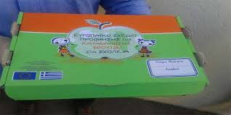
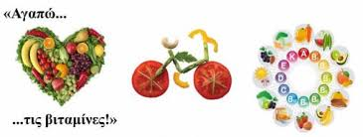

Greek reality
The last 5 years there has been an attempt to totally introduce fruit in school canteens and change the students' eating habits.

Slide 16
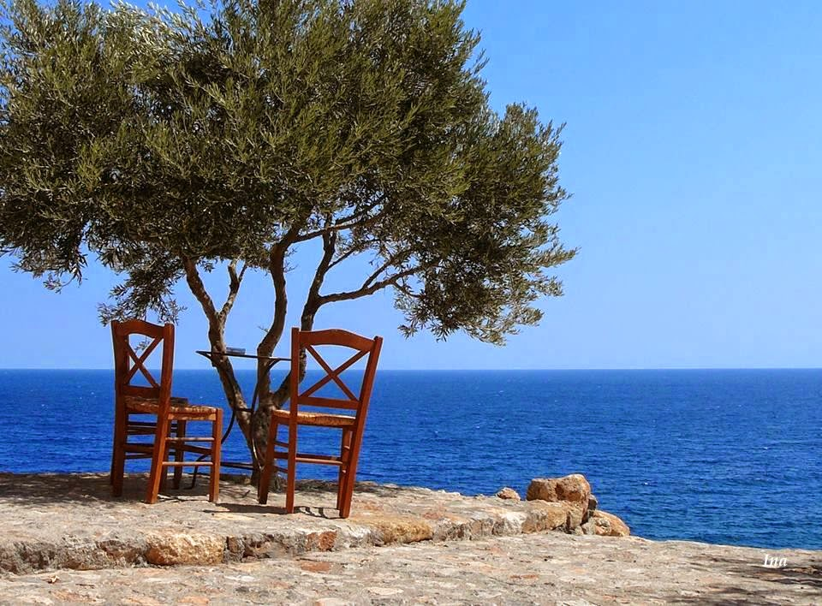
As a final note...
"Even if Greece is completely destroyed, an olive tree, a climbing vine and a boat will remain standing. These are enough to build it from scratch" Odysseus Elitis (Greek poet, awarded with a Nobel prize)
The Mediterranean Diet, as an expression of people's culture, is based on moderation, harmony and respect for natural environment. It constitutes a lifestyle which deserves to be adopted by the younger generation and it is an opportunity to return to familiar values.

